Slide 1





Dissecting and Streamlining the Interactive Loop of Mobile Cloud Gaming
Yang Li¹, Jiaxing Qiu¹, Hongyi Wang¹, Zhenhua Li¹, Feng Qian², Jing Yang¹, Hao Lin^{1,3}, Yunhao Liu¹, Bo Xiao⁴, Xiaokang Qin⁴, Tianyin Xu³
1
2
3
4
Notes:
Thanks for the introduction. Good afternoon everyone. I am Yang Li from Tsinghua University. Today I am giving a talk of our paper titled Dissecting and Streamlining the Interactive Loop of Mobile Cloud Gaming

Slide 2

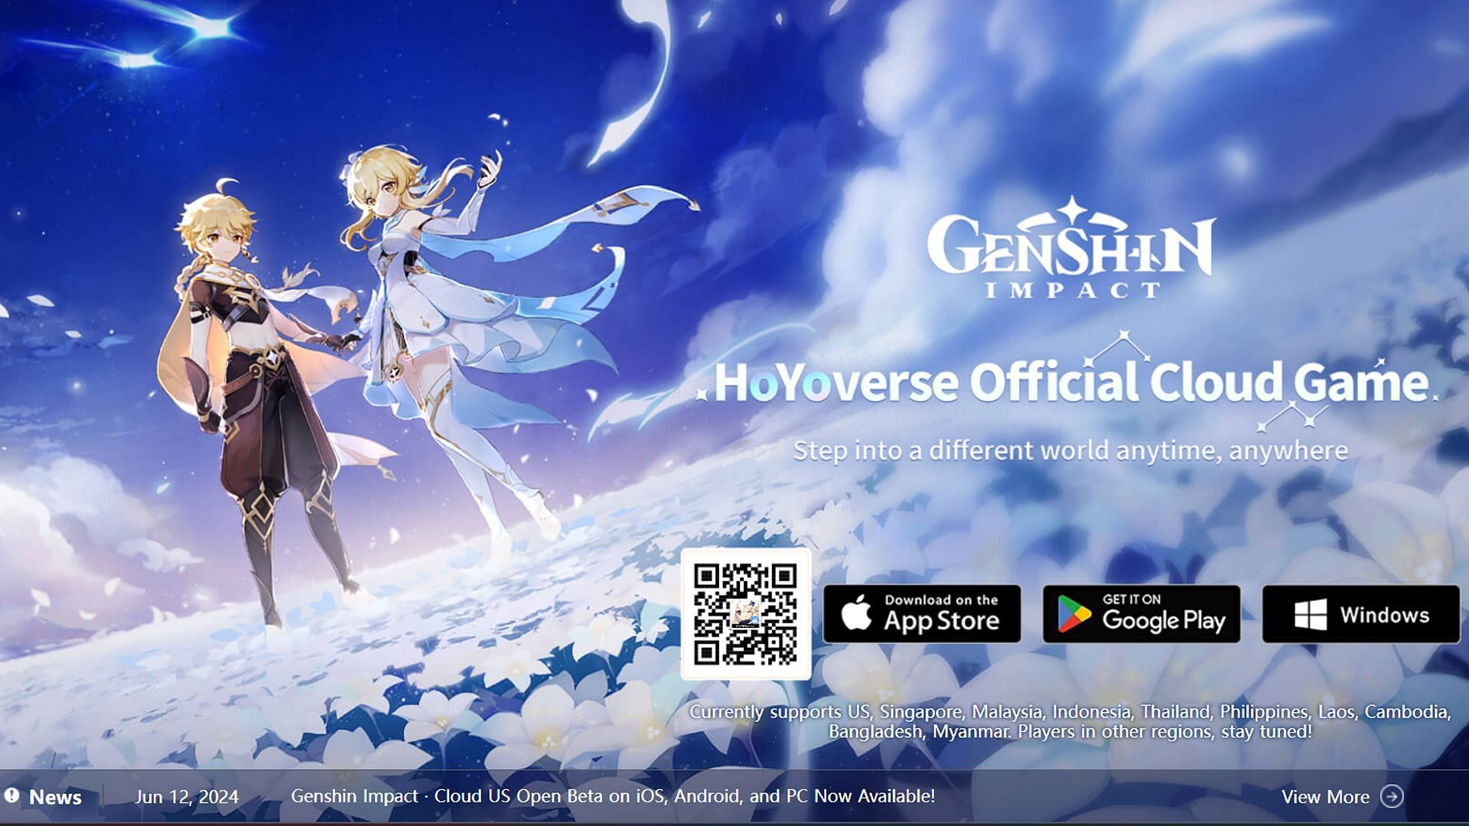

Cloud Gaming (CG) Apps are Emerging
CG enables high-quality gaming experiences on mid- to low-end devices
CG platforms have high performance requirements:
  High media streaming bandwidth (10+ MBps), low interactive latency (<100 ms)
Notes:
Recent years have witnessed the emergence and prosperity of cloud gaming, which enables high-quality gaming experiences on mid- to low-end devices.
To achieve smooth gaming experiences, CG platforms are expected to provide users with a high media streaming bandwidth and a low interactive latency within ∼100 ms.

Slide 3
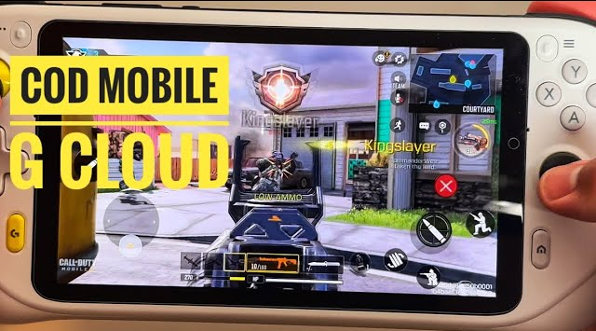
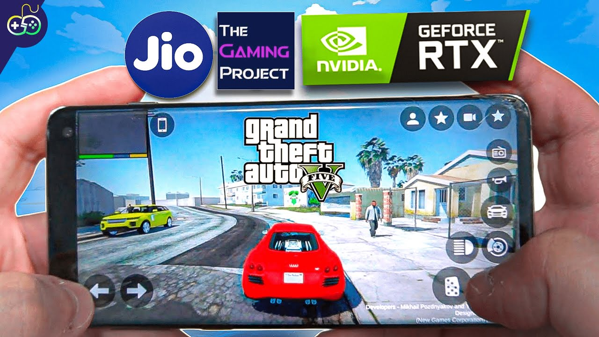
Interactive Latency is the Key QoE Metric
Cloud Gaming Apps
  Mobile Cloud Gaming (MCG): Cloud gaming for mobile games (e.g., COD Mobile)
  Console Cloud Gaming (CCG): Cloud gaming for console games (e.g., GTA5)
Interactive Latency
  The delay between a user-input action and when the game’s response to that action manifests at the client
  CG’s interactive latency has not been well understood
  It is more than network latency due to the complexity of cloud-side processing
MCG
CCG
Notes:
Here interactive latency is the delay between a user-input action and when the game’s response to that action manifests at the client.
Obviously, it is the key metric of cloud gaming apps‘ quality of experience.
Actually, cloud gaming apps can be divided into two categories, one is cloud gaming for mobile games like COD Mobile, we call it Mobile Cloud Gaming or MCG for short,
the other one is cloud gaming for console games like GTA5, we name it console cloud gaming or CCG for short.
Currently CG’s interactive latency has not been well understood by both the community and the industry.
It is more than network latency due to the complexity of cloud-side processing.

Slide 4



Understanding the Status Quo of CG’s QoE
CG involves UE, network, cloud
Commercial platforms are closed-source
Open-source solutions lack representativeness
How to measure interactive latencies of commercial CG platforms at scale?
Notes:
To understand the status quo of CG’s QoE, it is necessary to accurately measure the interactive latencies of commercial CG platforms.
However, it is quite challenging, given that CG involves complex interactions among multiple agents including User equipments, network and cloud servers.
Besides, almost all commercial platforms are closed-source, and open-source solutions often lack representativeness.

Slide 5
Understanding the Status Quo of CG’s QoE
Measurement from the outside in a record-and-recognize approach
CG involves UE, network, cloud
Commercial platforms are closed-source
Open-source solutions lack representativeness
How to measure interactive latencies of commercial CG platforms at scale?
Notes:
Given the above concerns, we measure the interactive latency of a platform from the outside in a record-and-recognize approach

Slide 6
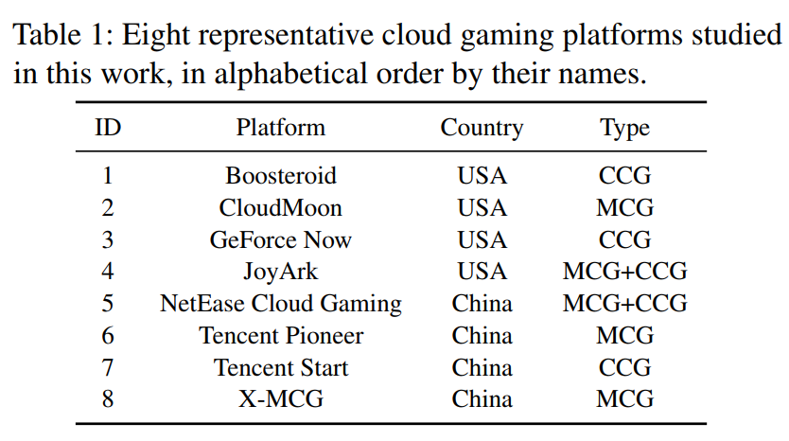
Interactive Latency Measurement
Target Platforms
  8 representative CG platforms
  3 support MCG alone, 3 support CCG alone
  2 support both
Notes:
As listed, we study 8 representative cloud gaming platforms that are popular in either the USA or China, using 100 mobile devices geo-distributed in both countries.
Among them, three are CCG platforms, three are MCG platforms, and two support both.

Slide 7


Interactive Latency Measurement
Target Platforms
  8 representative CG platforms
  3 support MCG alone, 3 support CCG alone
  2 support both
Methodology – Interactive latency
  Record:
    2 high-frame-rate cameras
      2000FPS, front and side views
    Specific interaction patterns
UE Screen
Side
Front
Notes:
To conduct measurement, we first use high-speed cameras to record videos of user interactions with games with an ultra-high frame rate of 2000 FPS and Full-HD resolution.
We position 2 cameras in front of and at the side of the device screen respectively, so that both user actions and visual game contents can be clearly observed.
We select specific interaction patterns for each game, e.g., invoking game menus, changing views, and touching in-game buttons.
They are performed with styluses instead of fingers to ease detection.

Slide 8

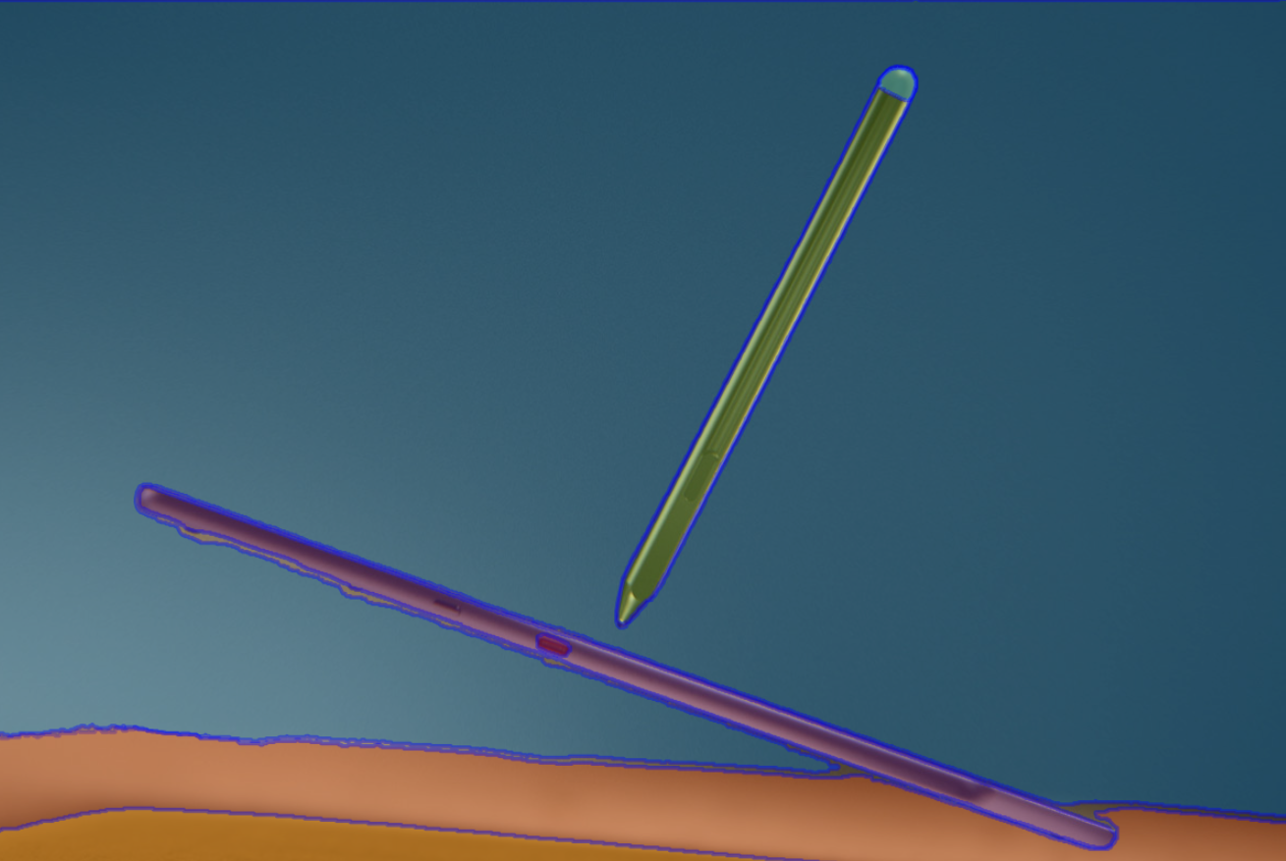
Interactive Latency Measurement
Target Platforms
  8 representative CG platforms
  3 support MCG alone, 3 support CCG alone
  2 support both
Methodology – Interactive latency
  Record:
    2 high-frame-rate cameras
      2000FPS, front and side views
    Specific interaction patterns
  Recognize:
    Segmentation Anything Model (SAM)
  Measurement error: up to 2 frames (~ 1 ms)
UE Screen
Side
Front
Object Segmentation
Notes:
After recording, we examine each frame with the Segmentation Anything Model to detect and track objects in the frames.
In this way, we can recognize the starting and ending timestamps of a user interaction.
Then the measured interactive latency is calculated as the difference between the two timestamps.

Slide 9

Interactive Latency Measurement
Methodology – Other metrics
  Network latency
    On-screen widgets presenting real-time metrics of the platform app
  Downlink bandwidth
    Lightweight Android API: NetworkStatsManager.querySummaryForDevice()
Dataset
  We conduct a month-long measurement (2023.5) and record 2w+ valid traces
An example from “Genshin Impact · Cloud”
Notes:
Further, we are curious about the network impact on the interactive latency since this is what common users are the most concerned with.
To address the concern, almost all the commercial cloud gaming platforms have on-screen widgets presenting the real-time network latency (via their client apps), which greatly facilitates our recording the network latency.
Since a low network bandwidth can also lead to high interactive latency, we periodically record the downlink bandwidth with a lightweight Android API in the meantime.
Finally, we obtain over 20,000 valid records, which reveal quite a few surprising results.

Slide 10
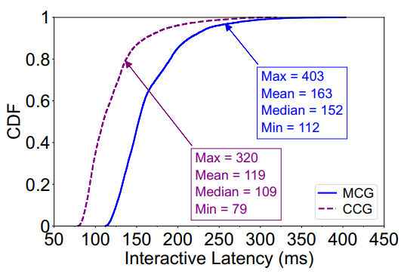
Key Measurement Findings
The interactive latency of today’s MCG cannot meet user requirements (<100 ms)
  All MCG platforms suffer from unsatisfactory interactive latencies (112-403 ms)
  In contrast, in 35% cases interactive latencies of CCG stay below 100 ms
  Even the fastest MCG platform (X-MCG) is slower than the slowest CCG one (JoyArk)
Notes:
First, we find that the interactive latency of today’s MCG cannot meet user requirements.
All the studied MCG platforms suffer from unsatisfactory interactive latencies, while the performance of CCG platforms is much better.

Slide 11
Key Measurement Findings
The interactive latency of today’s MCG cannot meet user requirements (<100 ms)
  All MCG platforms suffer from unsatisfactory interactive latencies (112-403 ms)
  In contrast, in 35% cases interactive latencies of CCG stay below 100 ms
  Even the fastest MCG platform (X-MCG) is slower than the slowest CCG one (JoyArk)
Implication: MCG’s processing logic is more complex than CCG
  CCG: hardware-assisted virtualization like SR-IOV
  MCG: para-virtualized GPU with additional virtualization logic
    Reason: poor driver support of desktop GPUs in mobile OSes
Notes:
We attribute the above to the more complex processing logic of MCG compared with CCG, that is, the mobile OS virtualization specially required by MCG.
Given the poor driver support of desktop GPUs in mobile OSes, there exists a gap in rendering performance between CCG and MCG backends.

Slide 12
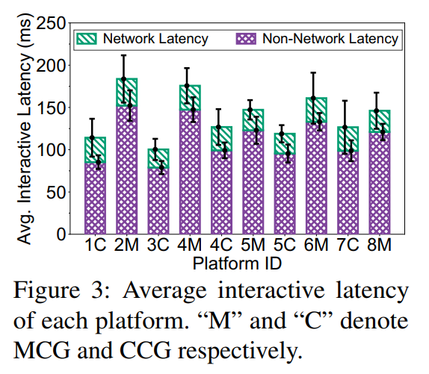
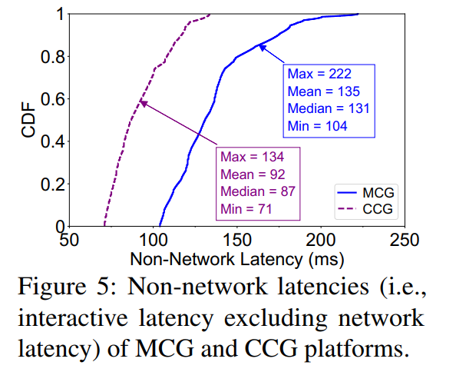
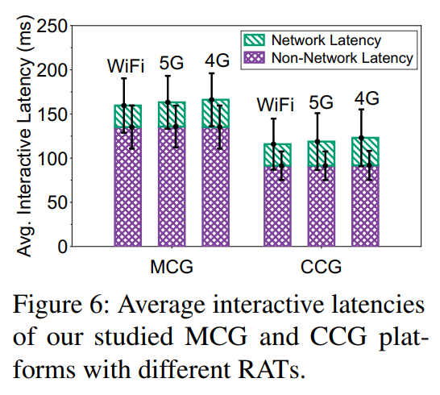
Key Measurement Findings
Network latency is not the performance bottleneck
  Most of the excessive MCG latency is not attributed to the network
  No matter which RAT is used, the network latency (averaging 24-31 ms) only takes up a small portion (averaging 15-25%) of the interactive latency
  Low network latency -> geo-distributed cloud/edge servers
    In 81% of the valid records, the user device lies in the same city as the cloud/edge server
Notes:
Second, contrary to most users’ common beliefs, most of the excessive MCG latency is not attributed to the network, as shown in the figures.
More in detail, no matter which RAT is used, the network latency only takes up a small portion of the interactive latency.
The network latency is pretty low in most cases, because all our studied platforms have deployed geo-distributed cloud servers across either the USA or China.

Slide 13
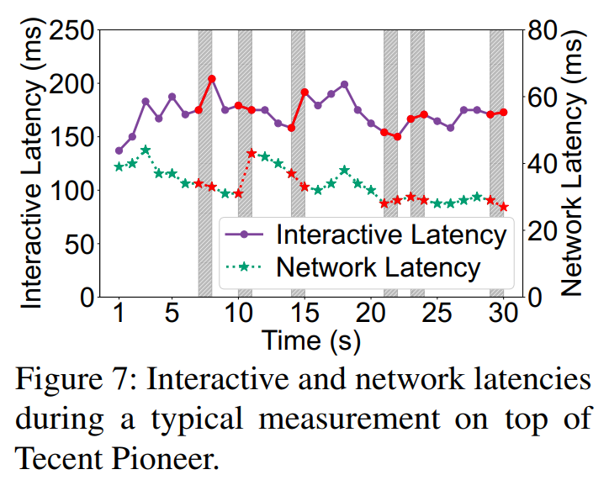
Key Measurement Findings
A lower network delay does not necessarily translate to a better interactive latency
  Common wisdom: positive correlation
  In a non-trivial portion (13%) of our measurements: negative correlation
Notes:
Besides, we observe that a lower network delay does not necessarily translate to a better interactive latency.

Slide 14
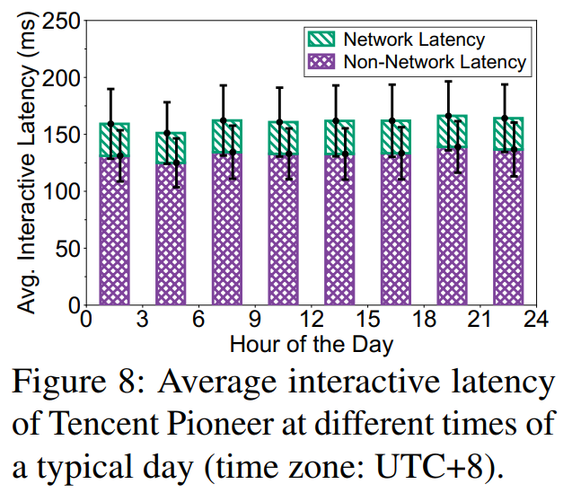
Key Measurement Findings
A lower network delay does not necessarily translate to a better interactive latency
  Common wisdom: positive correlation
  In a non-trivial portion (13%) of our measurements: negative correlation
MCG platforms possess sufficient scalability to serve diverse user request workloads
  There is no significant difference between interactive latencies during peak hours (12:00 – 21:00) and non-peak hours (00:00 – 12:00, 21:00 – 24:00)
Notes:
And regarding user request workload, we find that there is no significant difference between the interactive latencies during peak hours and non-peak hours, revealing that today’s MCG platforms possess sufficient scalability to serve a fluctuating user request workload.

Slide 15
Key Measurement Findings
A lower network delay does not necessarily translate to a better interactive latency
  Common wisdom: positive correlation
  In a non-trivial portion (13%) of our measurements: negative correlation
MCG platforms possess sufficient scalability to serve diverse user request workloads
  There is no significant difference between interactive latencies during peak hours (12:00 – 21:00) and non-peak hours (00:00 – 12:00, 21:00 – 24:00)
The resource allocation strategies of MCG platforms might be unbalanced
  On all MCG platforms, simple 2D games with light rendering workloads suffer from higher interactive latencies (10% on average) compared with graphics-intensive 3D games
Notes:
As for the game workload, we note that on all MCG platforms, simple 2D games with light rendering workloads suffer from higher interactive latencies compared with graphics-intensive 3D games.
According to existing documents of some MCG platforms, we suspect that this might be owing to unbalanced resource allocation strategies.

Slide 16
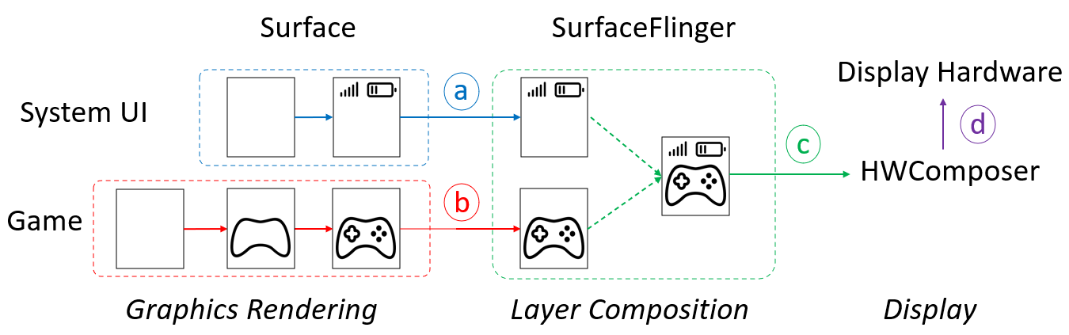
Diagnosing MCG’s Undesirable Interactive Latency
Mobile Graphics Pipeline
  The Android graphics pipelines consist of multiple stages due to diverse needs for graphics
Notes:
To discover the root causes behind the above observations, we first explore the mobile graphics pipeline.
The graphics pipelines of mobile OSes consist of multiple stages due to the users’ diverse needs for graphics; each stage performs its unique functionality.
When a game is played on an Android device, for instance, the game is typically the beginning of the graphics pipeline.
The game performs graphics rendering by writing its contents into a frame from a buffer queue termed Surface.
At the same time, other system apps like the system UI may render contents into their own Surfaces.
Various Surfaces are connected to a compositor called SurfaceFlinger, whose job is to merge the contents of individual Surface layers into one or more graphic frames for display.
The composited result is then sent to the Hardware Composer module, which submits the contents to the actual display hardware.

Slide 17
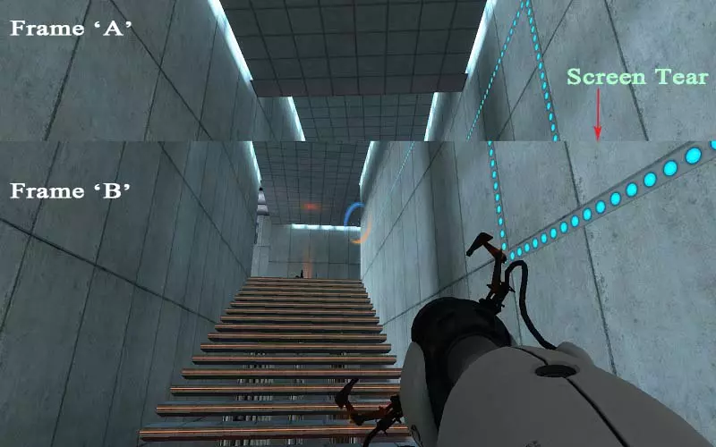
Diagnosing MCG’s Undesirable Interactive Latency
Mobile Graphics Pipeline
  The Android graphics pipelines consist of multiple stages due to diverse needs for graphics
  Stages a, b, c, d usually work in their own paces
  If their paces are not correctly synchronized, screen tearing occurs
Screen Tearing
Notes:
It is worth noting that the stages usually work in their own paces, which can cause frame access issues.
For example, while SurfaceFlinger regularly conducts Layer Composition at the refresh rate of the display, the pace of game rendering can be rather uncertain.
When the game delivers a new frame to SurfaceFlinger while it is compositing, the composited result may contain portions of multiple game frames, leading to the screen tearing problem.

Slide 18
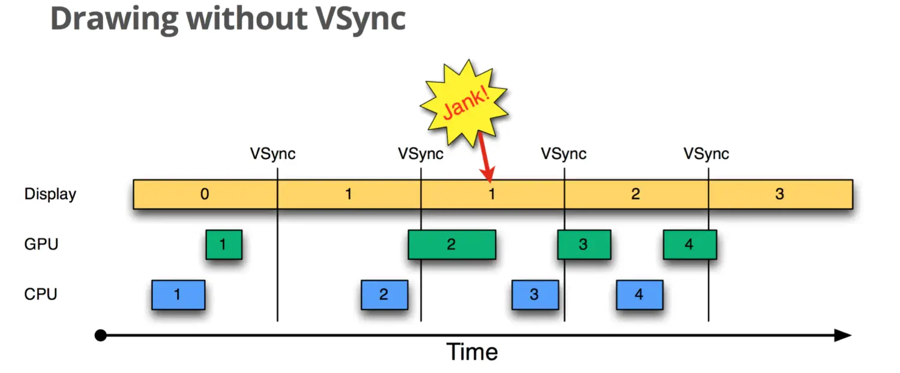
Diagnosing MCG’s Undesirable Interactive Latency
Mobile Graphics Pipeline (example: Stage c to d)
Notes:
To address screen tearing, modern mobile OSes typically adopt the VSync mechanism.
This figure presents an example of the pipeline from stage c to stage d before Android 4.1, where frames are displayed with VSyncs but drawing is processed without VSync.
In the first iteration, the screen displays frame 0, at which time the CPU and GPU render frame 1 and finish before the screen displays the next frame.
Because of the timely rendering, the buffer is swapped after frame 0 is displayed, which is after the 1st VSync, and then frame 1 is displayed normally in the second iteration.
Then frame 2 starts processing, which is not until just before the upcoming second VSync.
When the second VSync comes, the buffer is not swapped because frame 2 is not ready so frame 1 is still displayed.
This situation is named “Jank” by Android developers, which means a frame drop occurs.
We can see that when frame 2 is ready, it is not displayed immediately, but waits for the next VSync to perform a buffer swap before displaying it.
In this way, screen tearing can be avoided but the uncertain drawing paces cause frequent frame drops.

Slide 19
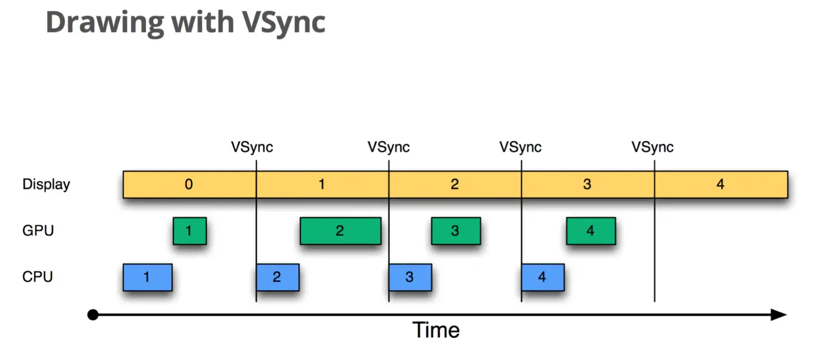
Diagnosing MCG’s Undesirable Interactive Latency
VSync: a classic access control mechanism for the graphics pipeline
  Frame production is driven by the signaling of VSync events to avoid janks
Notes:
To improve the display performance, Google has reconstructed the Android graphics system since Android 4.1.
As soon as the system receives the VSync event, the CPU and GPU will start rendering the next frame immediately.
As a result, frame drops can be significantly reduced.

Slide 20
Diagnosing MCG’s Undesirable Interactive Latency
VSync: a classic access control mechanism for the graphics pipeline
  Frame production is driven by the signaling of VSync events to avoid janks
  The production of a new frame should wait for the vertical blanking interval
Frame Consumer
Vertical blanking intervals create uncertain latencies and can accumulate in a lengthy pipeline!
Frame Producer
Vertical Blanking Intervals
Notes:
Overall, VSync works in an event-driven manner: frame consumption is triggered periodically by VSync events at a pace specified by the consumer.
In each period, when the producer finishes frame production, it waits for the vertical blanking interval, which is the time interval between the end of a production and the next VSync event of the consumer.
As shown, Vertical blanking intervals create uncertain latencies and the latencies can accumulate in a lengthy graphics pipeline, leading to unsatisfactory user experiences.

Slide 21
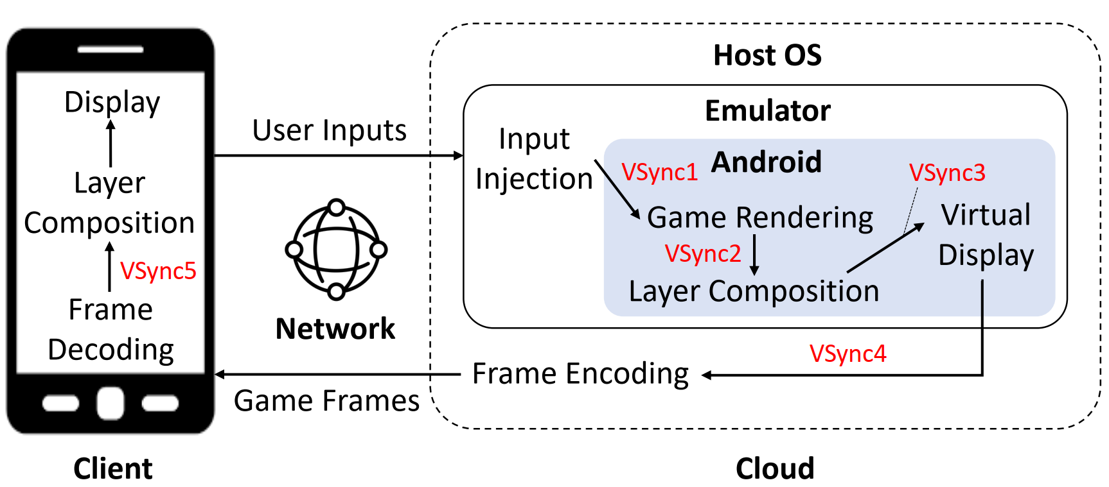
Diagnosing MCG’s Undesirable Interactive Latency
The interactive loop of X-MCG
Notes:
To further diagnose MCG’s undesirable Interactive Latency, we contacted the developers of the measured commercial MCG platforms.
Eventually, the developers of X-MCG agreed to share their design and collaborate with us to diagnose the undesirable interactive latency atop their platform.
The high-level interactive loop of X-MCG is shown in this figure.
As shown, a total of 5 VSync events exist to synchronize the paces of different stages in the graphics pipeline.

Slide 22
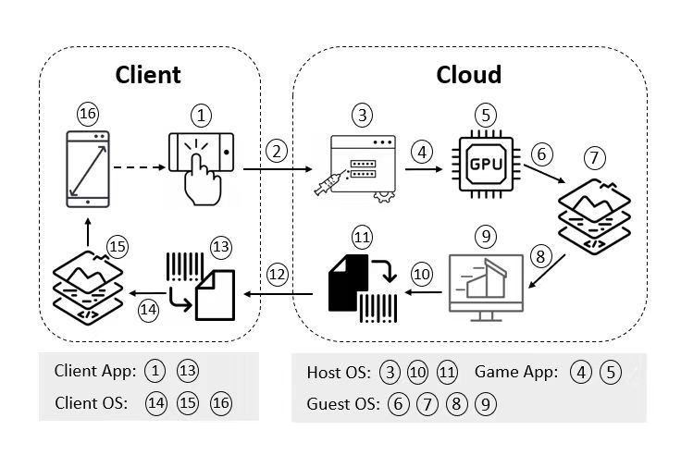
Diagnosing MCG’s Undesirable Interactive Latency
16 stages of the X-MCG interactive loop
  User Input Capture
  User Input Transmission
  User Input Injection
  VSync1
  Game Frame Rendering
  VSync2
  Cloud-side Layer Composition
  VSync3
  Virtual Display
  VSync4
  Game Frame Encoding
  Game Frame Transmission
  Game Frame Decoding
  VSync5
  Client-side Layer Composition
  Client Display
Notes:
The interactive loop of X-MCG comprises as many as 16 stages including 5 VSync events.
It involves complex interactions among multiple agents, as shown in this figure.

Slide 23
Diagnosing MCG’s Undesirable Interactive Latency
Root Cause Analysis
  Passive latency measurement to trace the data flow of a specific game frame
    Instrumenting Client Android, Cloud AOSP, Trinity, Sunshine/Moonlight
    Piggybacking timestamps with relevant network packets
Notes:
Among the 16 stages, we want to uncover which ones contribute the most to the interactive latency.
To this end, we conduct an in-depth measurement on the end-to-end loop of X-MCG using 10 phones whose OSes are tailored for detailed latency recording.
To precisely trace the data flow of a specific game frame in a lightweight manner, we measure passively by instrumenting relevant system modules and recording the timestamps of relevant network packets.

Slide 24
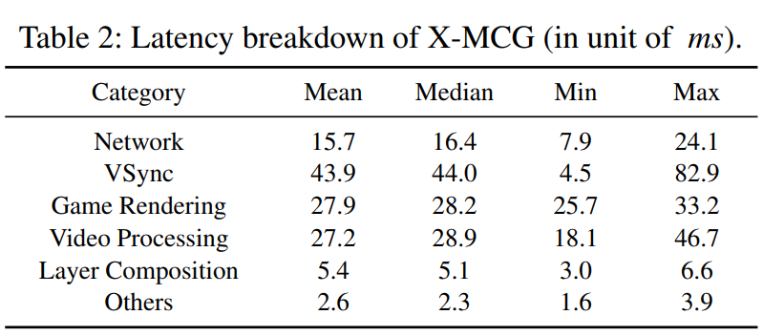
Diagnosing MCG’s Undesirable Interactive Latency
Root Cause Analysis
  Passive latency measurement to trace the data flow of a specific game frame
    Instrumenting Client Android, Cloud AOSP, Trinity, Sunshine/Moonlight
    Piggybacking timestamps with relevant network packets
    6 categories: Network (2,12), VSync (4,6,8,10,14), Game Rendering (5), Video Processing (11,13), Layer Composition (7,15), Others (3,9)
VSync is the biggest contributor to the interactive latency
Notes:
We classify the delays of the measurable stages in the loop into six categories, including Network, VSync, Game Rendering, Layer Composition, Video Processing, and Others.
Results in this table show that in terms of mean latency, the VSync mechanism contributes the most to the non-network latency, even more than Game Rendering and Video Processing.

Slide 25
Diagnosing MCG’s Undesirable Interactive Latency
Are these VSync events all necessary? Is it possible to disable VSync?
Notes:
So how can we minimize the VSync-induced delay? Are these VSync events all necessary? Is it possible to disable VSync?

Slide 26
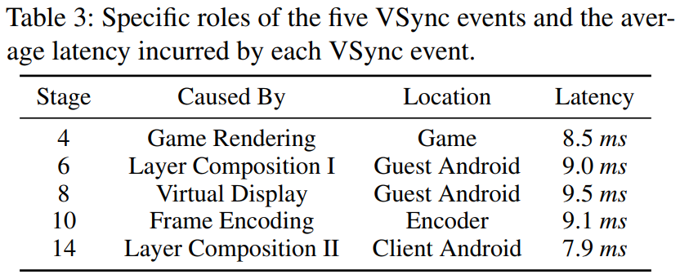
Diagnosing MCG’s Undesirable Interactive Latency
Are these VSync events all necessary? Is it possible to disable VSync?
  5 VSync events are tightly coupled with other stages
  VSync1 are built into modern game engines like Unity and Unreal
  VSync2, 3, and 5 are required by core graphics modules of Android system
  VSync4 is necessitated by the encoder to encode videos at user-defined frame rates
Notes:
To answer these questions, we delve deep into the loop and discover that 5 VSync events are tightly coupled with other stages.
VSync1 has been built into modern game engines like Unity and Unreal.
VSync2, VSync3, and VSync5 are required by core graphics modules of both cloud-side and client-side Android systems.
VSync4 is necessitated by the video encoder to encode videos at user-defined frame rates.

Slide 27
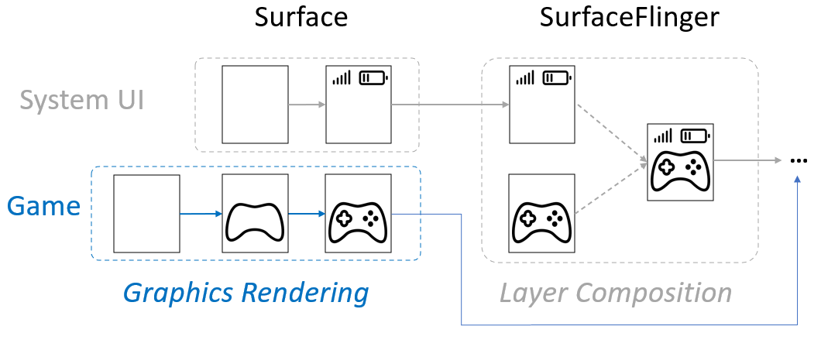
Diagnosing MCG’s Undesirable Interactive Latency
Are these VSync events all necessary? Is it possible to disable VSync?
  5 VSync events are tightly coupled with other stages
  VSync1 are built into modern game engines like Unity and Unreal
  VSync2, 3, and 5 are required by core graphics modules of Android system
  VSync4 is necessitated by the encoder to encode videos at user-defined frame rates
  They are structurally required but not every event is functionally useful!
Stages 6 and 8 only append game-irrelevant system UIs to a frame.
Notes:
Fortunately, while all the VSync events are structurally required and are hard to disable from the perspective of an MCG platform, not every VSync event is functionally useful.
In the context of MCG, games are usually the only foreground apps besides system UIs,
so Layer Composition and Virtual Display in the guest Android system only append game-irrelevant system UIs to a frame in almost all cases.
Thus, these stages along with their VSync events are functionally unnecessary for MCG, as the game frames are ready to be displayed on the client after Game Rendering.
This motivates our attempt to bypass some VSync events and decouple game rendering from the lengthy graphics pipeline, hoping to avoid or reduce their impact on the interactive latency.

Slide 28
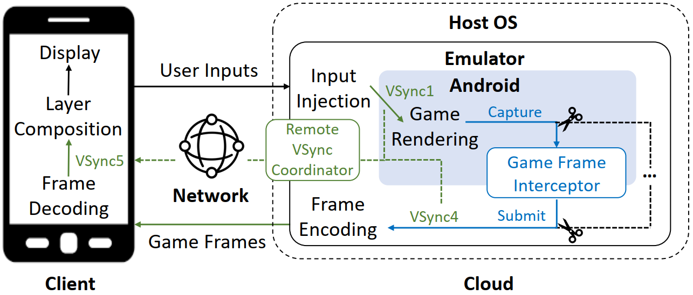
LoopTailor: Streamlining the X-MCG Interactive Loop
Core idea:
  Cropping the cloud-side graphics pipeline and stitching it to the client-side pipeline
Notes:
Guided by our diagnosis insights, we design LoopTailor, an adaptive VSync regulator.
This figure shows the architectural overview of LoopTailor, which streamlines the interactive loop of X-MCG by cropping the cloud-side graphics pipeline and stitching it to the client-side pipeline in a fine-grained manner.

Slide 29
LoopTailor: Streamlining the X-MCG Interactive Loop
Core idea:
  Cropping the cloud-side graphics pipeline and stitching it to the client-side pipeline
  Game Frame Interceptor (GFI): bypassing functionally unnecessary VSync events
  Remote VSync Coordinator (RVC): predicting and aligning the remaining VSync events
Notes:
LoopTailor has two key components: Game Frame Interceptor that efficiently captures the game frames ahead of schedule to bypass 2 VSync events;
and Remote VSync Coordinator that forecasts and synchronizes the remaining 3 VSync events by carefully coordinating the cloud and the client.

Slide 30
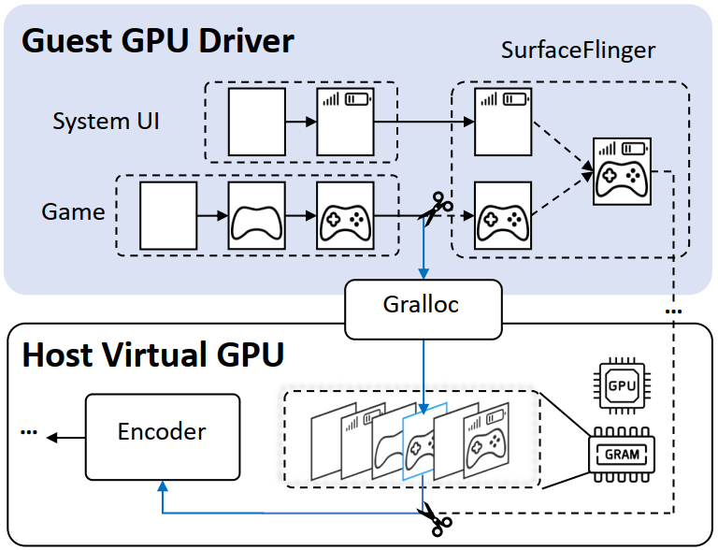
LoopTailor > Game Frame Interceptor
Core idea
  Leverage cross-layer information from both the guest OS and the host virtual GPU
  Intercept and forward handles (as opposed to the actual frame content)
  Stages 6-9 can be bypassed!
    VSync2 (6), cloud-side layer composition (7)
    VSync3 (8), virtual display (9)
Capture game frames in place!
Notes:
To realize low-overhead frame interception, our solution breaks the virtualization boundary and captures game frames in place.
This figure shows the workflow of GFI.
The core idea is to leverage cross-layer information from both the guest system and the host-side virtual GPU to intercept and forward handles, so as to minimize data copies.
To realize this, we customize the gralloc graphics allocator, the guest GPU driver, along with the virtual GPU device of the Trinity emulator.
Due to time limit, please refer to the paper for implementation details.
With the game frames intercepted, Stages 6-9 in the original graphics pipeline can be bypassed.

Slide 31
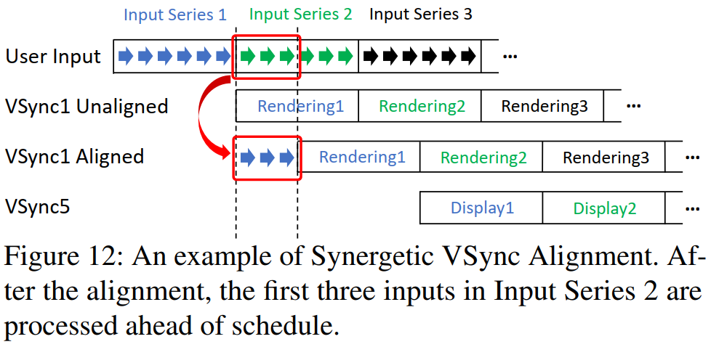
LoopTailor > Remote VSync Coordinator
Align the remaining 3 VSync events
Proactively synchronize the timing of VSync1 with VSync5
Reactively encode frames to avoid VSync4
Notes:
With the informative help of GFI, RVC aims to align the remaining three VSync events (VSync1, VSync4, and VSync5).
As VSync5 is controlled by the client OS and cannot be changed by a user app, RVC proactively synchronizes the timing of the cloud-side VSync1 and VSync4 with the client-side VSync5.

Slide 32
LoopTailor > Remote VSync Coordinator
VSync alignment requires predicting latencies between VSync1 and VSync5
  4 Stages: game rendering, frame encoding, network transmission, and frame decoding
Notes:
To this end, RVC first obtains the timing information of VSync5 from the Android frame pacing library in the client, and then predicts the delay of each intervening stage between VSync1 and VSync5.
There are four stages happening between VSync1 and VSync5: game rendering, frame encoding, network transmission, and frame decoding.

Slide 33
LoopTailor > Remote VSync Coordinator
VSync alignment requires predicting latencies between VSync1 and VSync5
  4 Stages: game rendering, frame encoding, network transmission, and frame decoding
  The latency of each stage can be independently forecast as a time series
  Summing independent forecasts makes highly biased results due to error propagation
Notes:
Although the latency of each stage can be independently forecast as a time series and summed directly to get the overall latency, the prediction result is oftentimes highly biased due to error propagation.

Slide 34
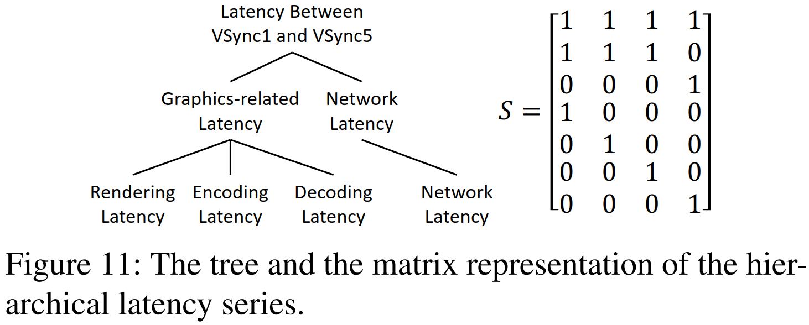
LoopTailor > Remote VSync Coordinator
VSync alignment requires predicting latencies between VSync1 and VSync5
  4 Stages: game rendering, frame encoding, network transmission, and frame decoding
  The latency of each stage can be independently forecast as a time series
  Summing independent forecasts makes highly biased results due to error propagation
  Key insight:
    The stages have latent correlations and their latencies can be hierarchically organized
    Refer to the paper for details of Hierarchical Time Series Forecasting
Hierarchical Time Series Forecasting
Notes:
To minimize the prediction error, our key insight is that the stages have latent correlations within the end-to-end graphics pipeline.
For example, if the game player suddenly enters a complex scene, game rendering will take longer time, the encoder will need more time to encode the frame as a standalone key frame (i.e., I frame), and the encoded frame will be larger in size, leading to longer network transmission time and longer client-side frame decoding time.
Also, we note that the involved latencies can be hierarchically organized as shown in this Figure. Therefore, we adopt hierarchical time series forecasting based on the MinT approach.
Due to time limit, please refer to the paper for the details of the forecasting.

Slide 35
LoopTailor > Remote VSync Coordinator
Synergetic VSync Alignment for VSync1
  Adjust the timing of VSync1 by blocking game rendering in the virtual GPU
  Use Monte Carlo sampling to minimize the delay expectation of n future frames in the pipeline, where n equals the forecast horizon
  Make part of inputs processed ahead of schedule
Notes:
With the predicted latencies in hand, the paces of VSync events can be adjusted in a synergetic fashion.
In practice, we adjust the timing of VSync1 by blocking game rendering in the virtual GPU.
We use Monte Carlo sampling to minimize the delay expectation of n future frames in the pipeline, where n equals the forecast horizon.

Slide 36
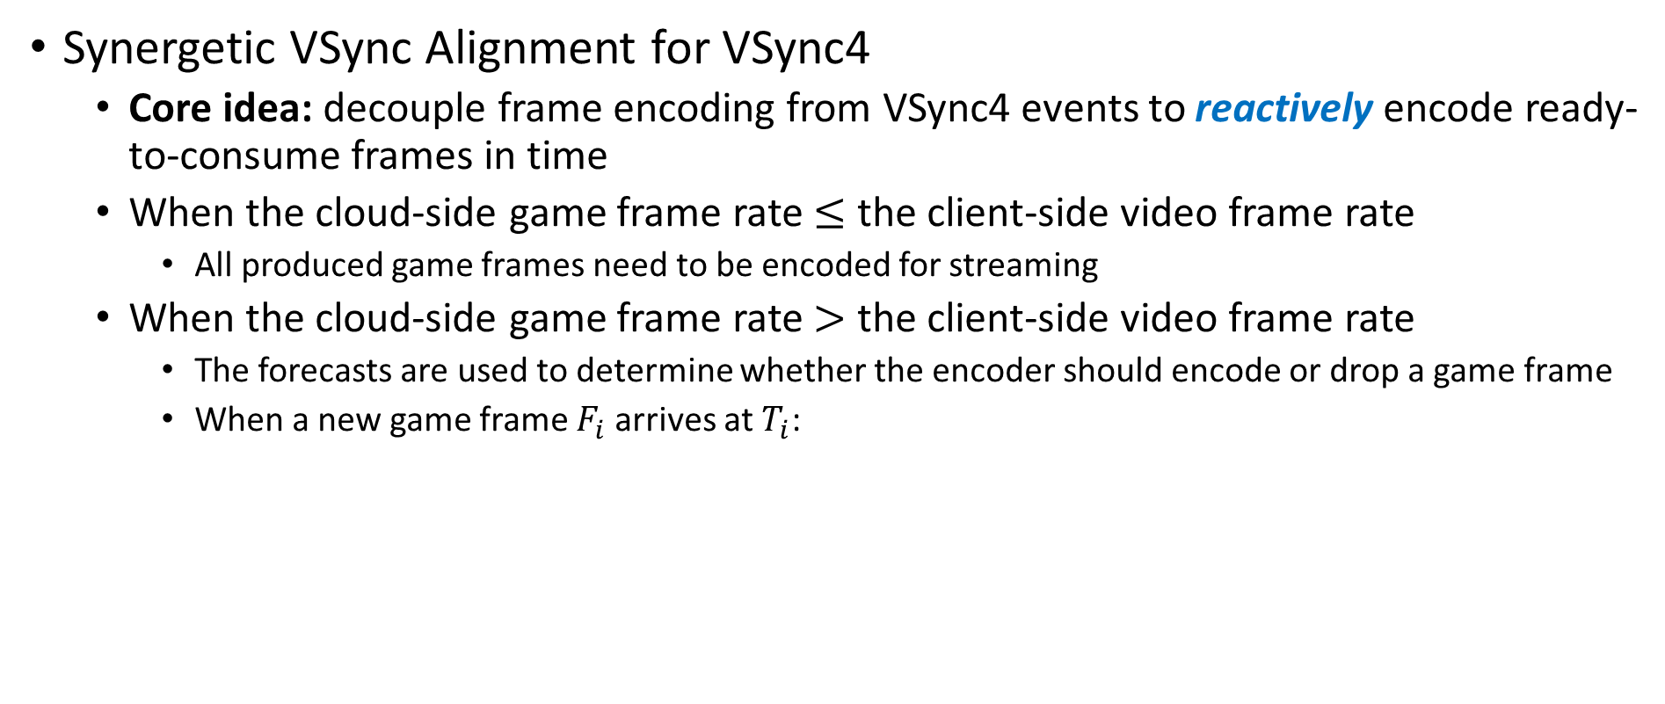


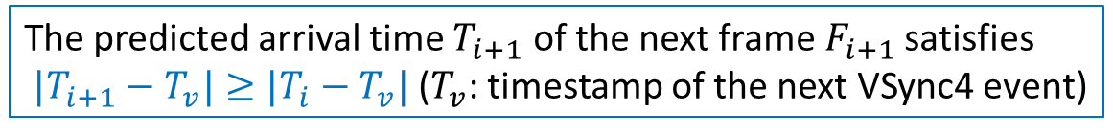
LoopTailor > Remote VSync Coordinator
Synergetic VSync Alignment for VSync4
  Core idea: decouple frame encoding from VSync4 events to reactively encode ready-to-consume frames in time
  When the cloud-side game frame rate $≤$ the client-side video frame rate
    All produced game frames need to be encoded for streaming
  When the cloud-side game frame rate $>$ the client-side video frame rate
    The forecasts are used to determine whether the encoder should encode or drop a game frame
    When a new game frame $F_{i}$ arrives at $T_{i}$:
True
The age of last encoded frame > one VSync interval
Encode $F_{i}$
False
True
The predicted arrival time $T_{i+1}$ of the next frame $F_{i+1}$satisfies
$|T_{i+1}−T_{v}|≥|T_{i}−T_{v}|$ ($T_{v}$: timestamp of the next VSync4 event)
Drop $F_{i}$
False
Notes:
As for VSync4, the core idea is to decouple frame encoding from VSync4 events to reactively encode ready-to-consume frames in time.
When the cloud-side game frame rate is lower than or equal to the client-side video frame rate, all produced game frames need to be encoded for streaming to satisfy the client-side requirement as much as possible.
Otherwise, the forecasts are used to determine whether the encoder should encode or drop a game frame, to match the video frame rate requested by the user.

Slide 37




Evaluation Setup
MCG platforms
  Our solution: X-MCG enhanced with LoopTailor (LoopTailor for short)
  Baselines: X-MCG + 4 representative MCG platforms
Netease Cloud Gaming
Tencent Pioneer
JoyArk
CloudMoon
Notes:
Collaborating with X-MCG, we deploy LoopTailor on their cloud infrastructure.
We also compare LoopTailor with other representative MCG platforms including Tencent Pioneer, NetEase Cloud Gaming, JoyArk, and CloudMoon.

Slide 38
Evaluation Setup
MCG platforms
  Our solution: X-MCG enhanced with LoopTailor (LoopTailor for short)
  Baselines: X-MCG + 4 representative MCG platforms
Other settings
  100 mobile devices
  Camera/game/network/streaming settings are the same as the measurement setup
  Evaluation in one month (2023.11), collecting 21,743 valid records
Netease Cloud Gaming
Tencent Pioneer
JoyArk
CloudMoon
Notes:
Regarding client devices, we leverage the 100 mobile devices used in our measurement study.
Other settings are the same as the measurement setup.
We collected evaluation data during a whole month, and collected over 20,000 valid records.

Slide 39
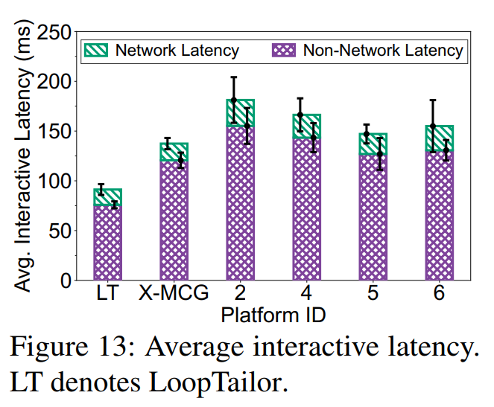
Evaluation Results
Interactive Latency
  33.6-50.7% lower
Non-network Latency
  37.1-51.1% lower
ID mappings
  LT: LoopTailor
  2: CloudMoon
  4: JoyArk
  5: Netease Cloud Gaming
  6: Tencent Pioneer
Notes:
As shown, LoopTailor yields the lowest average interactive latency as well as the non-network latency among all platforms.
Recall that a smooth gaming experience requires a sub-100 ms interactive latency, which is achieved by LoopTailor.

Slide 40
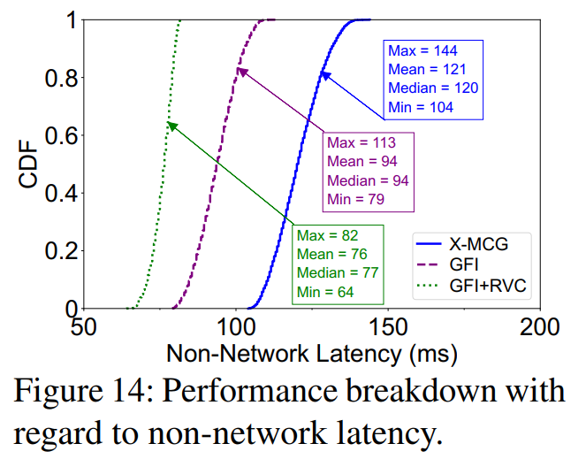
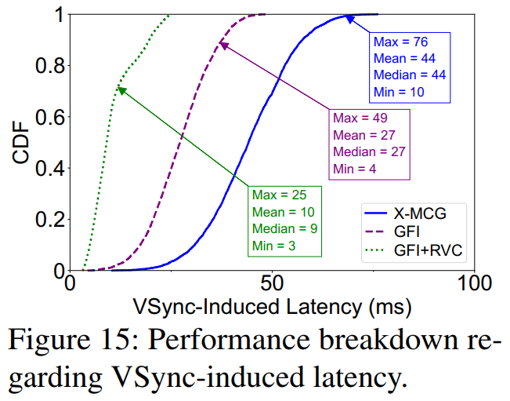
Evaluation Results
Performance Breakdown
  Compare with X-MCG
  Avg. non-network latency
    GFI: 22.3% lower
    GFI + RVC: 37.2% lower
  Avg. VSync-induced latency
    GFI: 38.6% lower
    GFI + RVC: 77.3% lower
Notes:
We also evaluate the performance gain brought by each module of LoopTailor, by enabling them incrementally.
Results demonstrate both GFI and RVC are essential for LoopTailor.

Slide 41

Conclusion
Network latency is not the key bottleneck of MCG’s performance
The biggest contributor of MCG’s interactive latency: the VSync mechanism
Key insight: VSync events are structurally required but not every one is functionally useful
34-51% lower interactive latency compared with commercial MCG platforms
Code and data available at: https://MCGlatency.github.io
Special thanks to Tsinghua Deng Feng Fund
Notes:
That’s the end of my talk, thank you for listening!

Slide 42
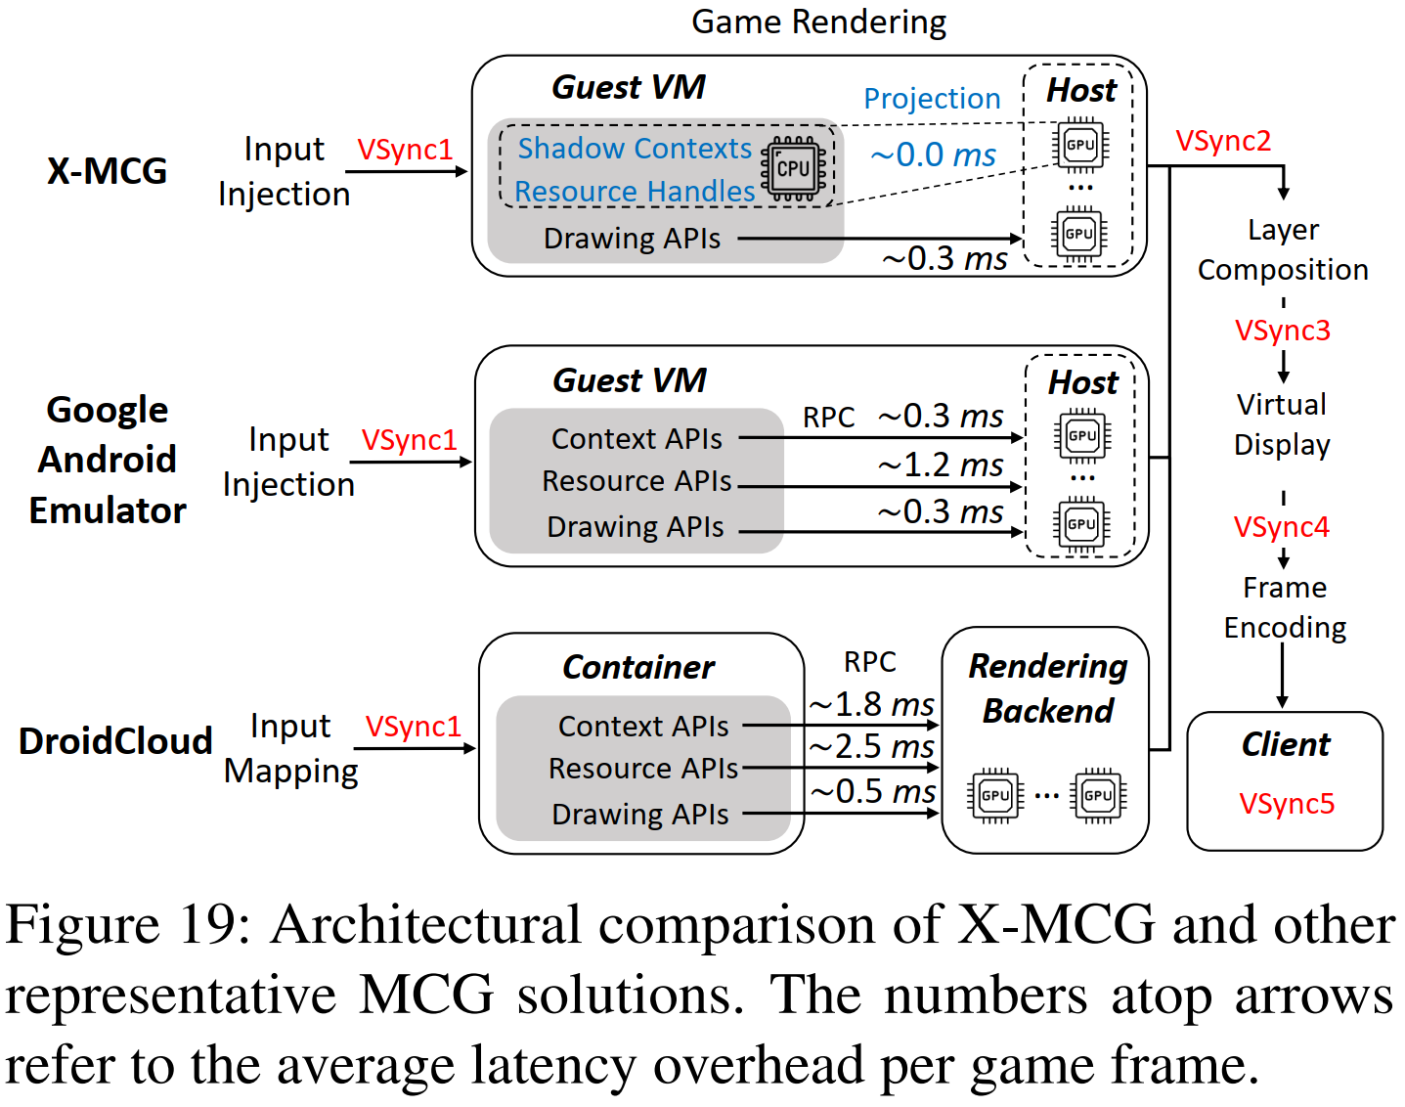
Discussion
Generalizability
  VSync1∼5 are not specific to X-MCG
  They are necessitated by
    The design of Android system
    The nature of constant-frame-rate encoding
Application Scope
  Middle/low-end devices
    Refresh rates are fixed and limited
    LoopTailor’s capability can be fully exploited
  High-end devices
    Refresh rates are high/adaptive
    The intervals between adjacent VSync5 events become variable/short
    Part of RVC (Alignment for VSync1) becomes less effective, others remain effective
Notes:
We argue that VSync1∼5 are not specific to X-MCG.
The defects of X-MCG found in our study are common to every Android- and video streaming-based MCG platform.
As shown, employing other solutions such as Google Android Emulator and DroidCloud also results in the five VSync events in the end-to-end graphics pipeline.
Thus, we believe that our insights and designs are widely applicable to other platforms.
As for the application scope, for middle/low-end devices whose refresh rates are fixed and limited, LoopTailor’s capability can be fully exploited.
For high-end devices with high or adaptive refresh rates, the intervals between adjacent VSync5 events become short or variable.
In such cases, part of RVC (Alignment for VSync1) becomes less effective, others remain effective, as VSync1∼4 are not on client devices.

Slide 43
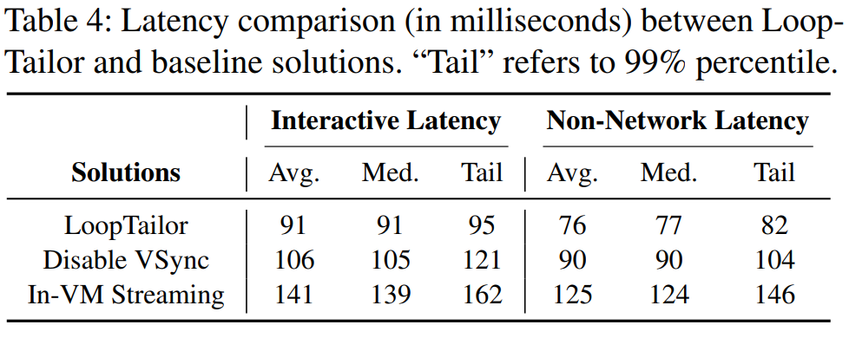
Evaluation Results
Intuitive baselines
  Disable VSync: since the client-side VSync5 and the in-game VSync1 cannot be controlled by an MCG platform, we disable VSync2/3/4 in the cloud
  In-VM Streaming: with the help of virtualized codec and NIC devices, videos are streamed in the guest OS (though the host NIC should still be used)
Interactive Latency
  14.2-35.5% lower
Non-network Latency
  15.6-39.2% lower
Notes:
We also implement two intuitive baseline solutions based on the X-MCG architecture to evaluate the performance of LoopTailor in more depth.
As shown, LoopTailor outperforms the baseline solutions in terms of both interactive latency and non-network latency.

Slide 44
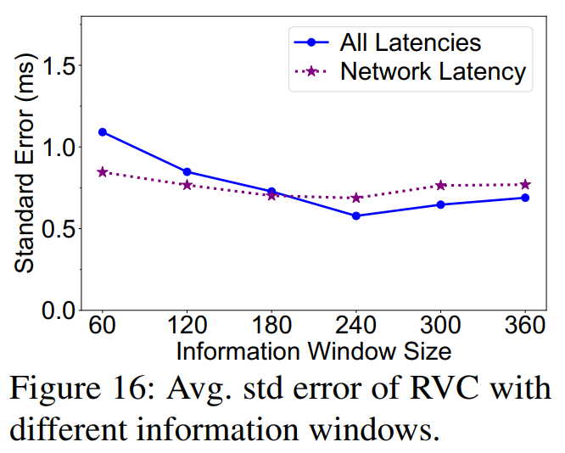
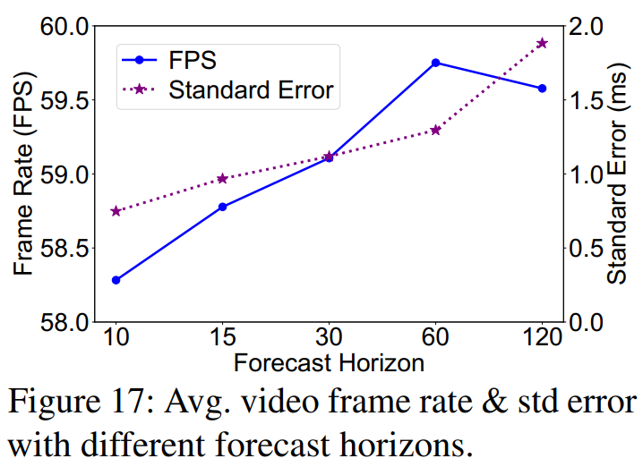
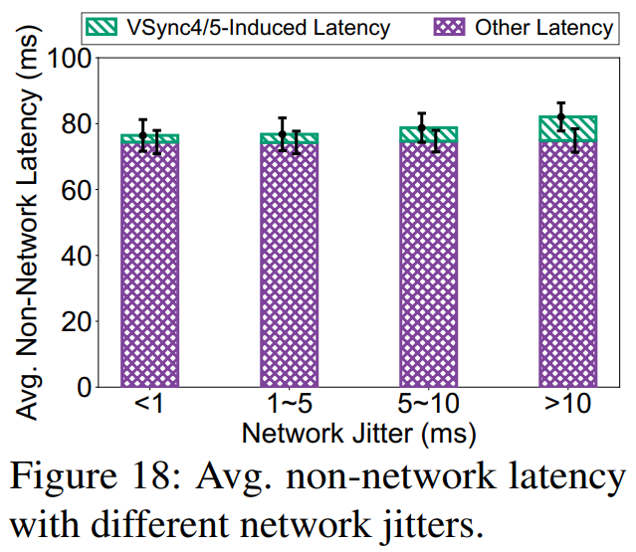
Evaluation Results
Micro Benchmarks
  Information window size: 240 -> lowest standard error (0.6 ms)
  Forecast horizon: 60 -> balance frame rate (59.7 FPS) and standard error (1.7 ms)
  LoopTailor is resilient to network jitters
Notes:
Besides, we perform micro benchmarks to select practical parameters of the latency forecasts.
Our experiments also prove that LoopTailor is resilient to network jitters.

Slide 45



LoopTailor > Game Frame Interceptor
Frame capture from game rendering ahead of time
Before any form of layer composition
Existing intuitive methods
  App-level render redirection
    Redirect the app rendering Surface to a virtual display with hooking libraries such as Xposed
    Use the MediaProjection API to directly record rendered contents
  Framework-level buffer hooking
    Add a hook inside Surface
    Perform interceptions whenever a game-owned Surface delivers a frame to SurfaceFlinger
Host
Additional guest-host data copies!
Guest OS
NIC
…
…
copy
Client
Both approaches capture frames solely from inside the guest,
but ultimately send the frames using the network provided by the host.
Notes:
GFI aims to capture raw frames from game rendering ahead of time, before any form of layer composition.
In Android, the desired interception should take place between the game app and SurfaceFlinger, and there exist multiple intuitive methods.
For instance, app-level render redirection redirects the app rendering Surface to a virtual display with hooking libraries such as XPosed, and uses the MediaProjection API to directly record rendered contents.
Framework-level buffer hooking adds a hook inside Surface, and performs interceptions whenever a game-owned Surface delivers a frame to SurfaceFlinger.
However, they both capture frames solely from inside the guest, but ultimately send the frames using the network provided by the host, incurring considerable frame copy overheads.

